Slide 1
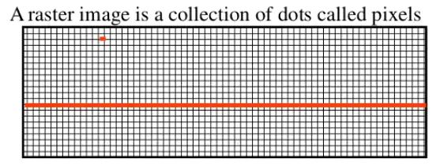
What is raster scan?
A raster scan, or raster scanning, is the rectangular pattern of image capture and reconstruction.
Raster Scan Displays are most common type of graphics monitor which employs CRT.
It is a systematic process of covering the area progressively, one line at a time.
Raster images are created with pixel-based programs or captured with a camera or scanner.
They are more common in general such as jpg, gif, png and are widely used on the web.

Slide 2
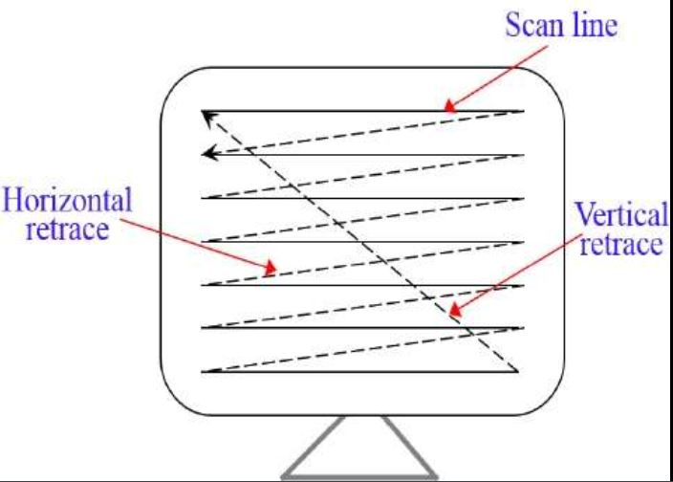
How raster scan works:
In a raster scan system, the electron beam is swept across the screen, one row at a time from top to bottom.
As the electron beam moves across each row, the beam intensity is turned on and off to create a pattern of illuminated spots.
The return to the left of the screen, after refreshing each scan line is called Horizontal retrace. At the end of each frame the electron beam returns to the top left corner of the screen to begin the next frame is called Vertical retrace:

Slide 3
Picture definition is stored in a memory area called the refresh buffer or frame buffer. Refresh buffer or frame buffer is memory area that holds the set of intensity values for all the screen points.
Stored intensity values then retrieved from refresh buffer and "painted° on the screen one row (scan line) at a time.
The quality of a raster image is determined by the total number pixels (resolution), and the amount of information in each pixel (color depth)
A black-and-white system: each screen point is either on or off, so only one bit per pixel is needed to control the intensity of screen positions. Such type of frame buffer is called Bit map
High quality raster graphics system have 24 bits per pixel in the frame buffer (a full color system or a true color system)
Refreshing on raster scan displays is carried out at the rate 60 to 80 frame per second.

Slide 4
Advantages and Disadvantages:
ADVANTAGES:
Real life images with different shades can be displayed.
Color range available is bigger than random scan display.
DISADVANTAGES:
Resolution is lower than random scan display.
More memory is required.
Data about the intensities of all pixel has to be stored.

